Slide 1
31284 Web Services Development
Autumn 2012
Review
Week 14 - Review
Notes:
31284 Web Services Development
Week 14 - Review
© Copyright UTS Faculty of Information Technology 2012

Slide 2
Week 1 - Ebusiness
Business/Revenue models
B2C
B2B
EAI
Week 14 - Review
Notes:
31284 Web Services Development
Week 14 - Review
© Copyright UTS Faculty of Information Technology 2012

Slide 3
Business Models
B2C
Portal
E-tailer
Content Provider
Transaction Broker
Market Creator
Service Provider
Community Provider
B2B
E-Distributor
E-procurement
Exchanges (B2B Hub)
Industry Consortia
Private Industrial networks
Week 14 - Review
Notes:
31284 Web Services Development
Week 14 - Review
© Copyright UTS Faculty of Information Technology 2012

Slide 4
Revenue Models
Advertising
Subscription
Transaction Fee
Sales
Affiliate
Week 14 - Review
Notes:
31284 Web Services Development
Week 14 - Review
© Copyright UTS Faculty of Information Technology 2012
This slide shows some of the typical ways a company can make money on the Internet (the revenue model). Every business model will typically have one or more associated revenue models.
Advertising – advertisers pay to place advertisements on a web site / web application. Banner ads are commonly used, but sometimes the advertising is more subtle, e.g. a company may pay to have their name used frequently within the text on the site, so it looks less obviously like advertising.
Subscription – subscribers pay for access to certain valuable content or services.
Transaction fee – the web site takes a commission from users of the web site, e.g. a percentage of the total sale price. This is often done where the web site is acting as an intermediary between a buyer and a seller (e.g. auction sites).
Sales – the most basic revenue model – revenue is generated from sales.
Affiliate – the web site owner generates revenue (like commissions) dependent upon the number of referrals they offer to third parties. Like the transaction fee model, this is often used when the web site is an intermediary between buyers and sellers. For each referral a seller receives, they pay the site owner a small fee for the referral.
K. Launden, C. Traver, E-commerce, Addison-Wesley, 2002, p. 61.

Slide 5
Week 2 - Technologies
Distributed Computing
Generic Architectures
  Client/Server
  Three-tier
  N-tier
  Peer-Peer
Server components (firewalls, CMS, etc)
Technologies (J2EE, .NET)
Week 14 - Review
Notes:
31284 Web Services Development
Week 14 - Review
© Copyright UTS Faculty of Information Technology 2012

Slide 6
Week 3 - Programming
Building distributed applications
(“programming paradigms”)
  sockets, RPC, web services/REST, middleware (DOM & MOM)
Web based distributed applications
  server side processing
    CGI, Servlets, JSP, …
  client side processing
    JavaScript, Applets, …
Week 14 - Review
Notes:
31284 Web Services Development
Week 14 - Review
© Copyright UTS Faculty of Information Technology 2012

Slide 7
Week 4 - Designing
RM-ODP – 5 viewpoints
  Enterprise (view from 30000 ft)
  Information (semantics of information)
  Computational (partitioning)
  Engineering - characteristics
  Technology
Week 14 - Review
Notes:
31284 Web Services Development
Week 14 - Review
© Copyright UTS Faculty of Information Technology 2012

Slide 8
Designing – technical side
Engineering – Characteristics
  resource sharing – sharing/locality
  openness
  concurrency – principle of parallelism
  scalability - performance! (all 3 principles)
  fault tolerance
  transparency
Principle of Sharing – client ←→server
  Gartner classifications
Principle of Locality – keep data/code together
Parallelism Principle – maximise concurrency
Week 14 - Review
Notes:
31284 Web Services Development
Week 14 - Review
© Copyright UTS Faculty of Information Technology 2012

Slide 9
Gartner classification of C/S
Client
presentation
logic
presentation
logic
presentation
logic
presentation
logic
presentation
logic
business
logic
business
logic
business
logic
data
access
presentation
logic
Server
business
logic
business
logic
business
logic
data
access
data
access
data
access
data
access
data
access
distributed
data
remote
data
distributed
transaction
remote
presentation
distributed
presentation
Week 14 - Review
Notes:
31284 Web Services Development
Week 14 - Review
© Copyright UTS Faculty of Information Technology 2012
So far we have considered resource sharing in the context of thin-client and fat-client architectures. In fact, often distributed applications are classified into more specific categories than just these two. Different authors have differing numbers of categories (e.g. some have five, some have seven). Here we examine the Garter Group classification of client/server systems into five distinct categories as shown in the slide. The Gartner models are fairly widely known in the distributed computing world, and although getting a bit old now, still illustrate nicely some of the choices that one can make when designing a distributed application.
The Gartner models range from fat client on the left through to thin client on the right. 'Distributed Transaction' (in the middle) is somewhat of a hybrid. Upcoming slides examine the meaning of each of these models in a little more detail. Note that in the diagrams shown on the slide, the client-side is at the top of the picture, and the server-side is at the bottom.
The Gartner Group models come from:
James Cassell. The Total Cost of Client/Server: A Comprehensive Model, A Gartner Group Conference on the Future of Information Technology Industry, November 10-11, 1994.
and is based on a model originally presented in:
Alex Berson. Client/Server Architecture, McGraw-Hill, 1992

Slide 10
Then came XML!!! (Weeks 5-10)
XML Introduction
XML Namespaces
DTD/XML Schema
XML programming
XSLT/XPATH
Week 14 - Review
Notes:
31284 Web Services Development
Week 14 - Review
© Copyright UTS Faculty of Information Technology 2012

Slide 11
Some things to know
XML - structure [elements, entities, comments, DTD declaration, processing instructions, CDATA ..]
document vs data centric
well formed → ie: parses ok
valid → conforms to DTD or Schema
Week 14 - Review
Notes:
31284 Web Services Development
Week 14 - Review
© Copyright UTS Faculty of Information Technology 2012

Slide 12
XML Namespaces/Schema
DTD: (old technology)
  define elements & attributes
  and order of elements
Namespaces: prefix xmlns:name
XML Schema:
  built-in datatypes eg: xsd:string
  datatype restrictions, e.g. patterns (regular expressions)
  simpleType vs complexType
Week 14 - Review
Notes:
31284 Web Services Development
Week 14 - Review
© Copyright UTS Faculty of Information Technology 2012

Slide 13
XML programming
DOM = Document Object Model
    parser reads in the entire XML document
    builds an in-memory tree representation
    You write recursive tree processing
SAX = Simple API for XML
    parser reads the XML document linearly
    triggers an event
    You write Content handler, using callback
Week 14 - Review
Notes:
31284 Web Services Development
Week 14 - Review
© Copyright UTS Faculty of Information Technology 2012

Slide 14
XPATH/XSLT
Transform XML to another format
XSLT walks the XML tree
XPATH: treat tree like ‘pseudo directory’
XSL template: matches expression
  starts at root element (/)
  apply-templates triggers next pattern
  XSLT includes logic, variables, functions
Week 14 - Review
Notes:
31284 Web Services Development
Week 14 - Review
© Copyright UTS Faculty of Information Technology 2012

Slide 15
Week 11 - Web services
Introduction to Web Services
  XML based messaging
  Re-use Web (HTTP) technologies
  Technology/vendor neutral
  Wide acceptance
Enabling technologies:
  SOAP
  WSDL
  UDDI
Week 14 - Review
Notes:
31284 Web Services Development
Week 14 - Review
© Copyright UTS Faculty of Information Technology 2012

Slide 16
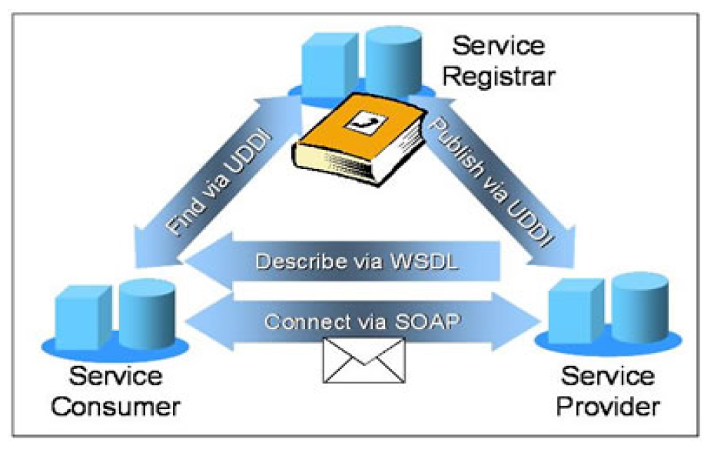
Web Services
Week 14 - Review
Notes:
31284 Web Services Development
Week 14 - Review
© Copyright UTS Faculty of Information Technology 2012

Slide 17
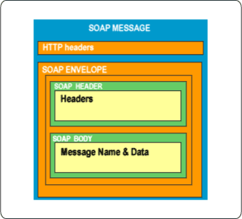
SOAP
“Simple Object Access Protocol”
SOAP message contains:
  Envelope:
  describes the message and how to process it
  Header:
  contains the features of the SOAP message
  Body:
  contains the primary information for the message receiver
Week 14 - Review
Notes:
31284 Web Services Development
Week 14 - Review
© Copyright UTS Faculty of Information Technology 2012

Slide 18
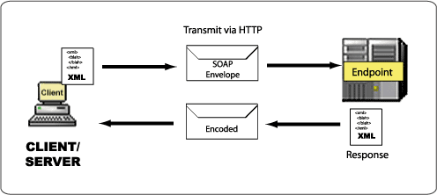
SOAP
SOAP works by transmitting XML between the Consumer and Provider.
Week 14 - Review
Notes:
31284 Web Services Development
Week 14 - Review
© Copyright UTS Faculty of Information Technology 2012

Slide 19
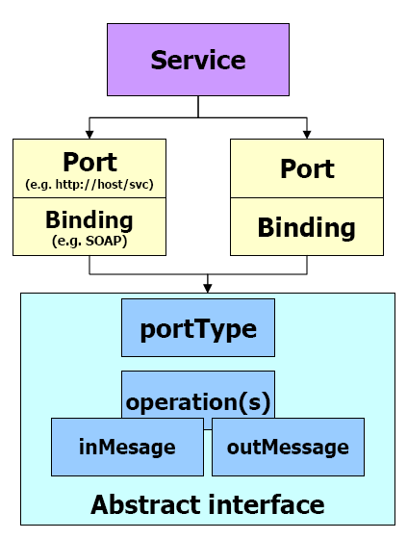
WSDL Structure
Service:
  collection of endpoints
  endpoint = port + binding
Binding:
  maps operations to protocols (e.g. SOAP via HTTP)
Port type:
  a set of operations supported by endpoints (like a function library)
Operation:
  abstract description of an action supported by a service
Message:
  typed definition of data communication (input and output)
Week 14 - Review
Notes:
31284 Web Services Development
Week 14 - Review
© Copyright UTS Faculty of Information Technology 2012

Slide 20
Week 12
Web Services interaction patterns
WS-I – Basic Profile
Web Services security
REST
Week 14 - Review
Notes:
31284 Web Services Development
Week 14 - Review
© Copyright UTS Faculty of Information Technology 2012

Slide 21
Web services Interactions
SOAP allows 4 main types of interactions
one-way: →
  send a message, no response needed
request-response: → ←
  like RPC
solicit-response: ? → ←
  Ask for response, & wait
notification: ←
  “listen” for incoming messages
“direct”
“queued”
Week 14 - Review
Notes:
31284 Web Services Development
Week 14 - Review
© Copyright UTS Faculty of Information Technology 2012

Slide 22
RPC vs. Document Style
RPC style
  Client ← → server
  Synchronous
  Request-response, pass parameters to method()
  We are used to programming this way
Document Style
  May be direct/synchronous or queued/asynchronous
  1 parameter (XML document) exchanged between service clients and servers
  Many business functions may be better supported by message-style interaction eg: invoices
Week 14 - Review
Notes:
31284 Web Services Development
Week 14 - Review
© Copyright UTS Faculty of Information Technology 2012
- RPC - Simple Request-Response protocol to invoke a remote method

Slide 23
WS-I Basic Profile
Existing standard ambiguous, vendors not working together
➔ WS-I created the Basic Profile 1.0
This clarified SOAP rules eg:
  Only Document/Literal web services are allowed
  ie: only exchange XML documents
  cannot use SOAP Encoding
  e.g. NO method(param1, param2) calls
  Must use HTTP bindings
  Only can use one-way or request-response
  more clearer definition of WSDL rules
  plenty of more clarifications of rules
Week 14 - Review
Notes:
31284 Web Services Development
Week 14 - Review
© Copyright UTS Faculty of Information Technology 2012

Slide 24
REST
Conceptually simple
Everything in a system consists of Resources
eg: web page
Each resource is:
  uniquely addressable eg: URL/URI
  common interface for transfer of state
  has well defined operations (usually CRUD ie: Create, Read, Update, Delete + find)
  state information is not stored between sessions
Your operations exchange state information about the resource
Week 14 - Review
Notes:
31284 Web Services Development
Week 14 - Review
© Copyright UTS Faculty of Information Technology 2012

Slide 25
Week 13 SOA
Service Oriented Architecture
Instead of Classes, Functions, Methods, Objects etc
→ use services for developing applications.
Basic concept:
  basic services and their descriptions
  binding of services
  publication, discovery & selection of services
Week 14 - Review
Notes:
31284 Web Services Development
Week 14 - Review
© Copyright UTS Faculty of Information Technology 2012

Slide 26
Changes in computing paradigms
SOA
  We keep upgrading! ... Service Oriented!
loosely-coupled
composable
Web, grid, P2P
Distributed
service-
oriented
component-
oriented
Client Server
object-
oriented
Mainframe
structured
programming
Week 14 - Review
Notes:
31284 Web Services Development
Week 14 - Review
© Copyright UTS Faculty of Information Technology 2012

Slide 27
SOA pyramid
More generalised...
Service
locator
find
publish
Service
consumer
Service
provider
bind
Week 14 - Review
Notes:
31284 Web Services Development
Week 14 - Review
© Copyright UTS Faculty of Information Technology 2012

Slide 28
So what are services?
services are self-describing, open components
  support low-cost composition
  no interdependencies! ie: stateless
service providers
  organisations that procure service implementations
  provide service descriptions
  provide runtime environment
service locators advertise
  service capabilities
  interface (signature) + behaviour (workflow)
  Quality of Service, (QoS), security, availability etc
technology neutral, supports location transparency
Week 14 - Review
Notes:
31284 Web Services Development
Week 14 - Review
© Copyright UTS Faculty of Information Technology 2012

Slide 29
Web 2.0
2nd generation of the web
innovative use of existing (& new) browser based technologies
collaboration & sharing
  Portals, wiki’s, blogs, syndication (RSS)
  social networking
  user-oriented, not provider-oriented
  Mashups – combine multiple SOA services into one application
Week 14 - Review
Notes:
31284 Web Services Development
Week 14 - Review
© Copyright UTS Faculty of Information Technology 2012

Slide 30
The EXAM
Week 14 - Review
Notes:
31284 Web Services Development
Week 14 - Review
© Copyright UTS Faculty of Information Technology 2012

